Slide 1

Bubble
Team 4 (Hun-Min Park, Sang-Gyun An, JongMin Jin)

Slide 2
Project schedule
Step 1
Project
Setup
Step 2
Basic graphics
&
physics
Step 3
Advanced graphics
Step 4
Alpha ver.
Step 5
Beta ver.
Presentation 1 (10/13)
Presentation 2
(11/03)
Presentation 3 (11/17)
Presentation 4
(12/01)
Final
(12/14)

Slide 3
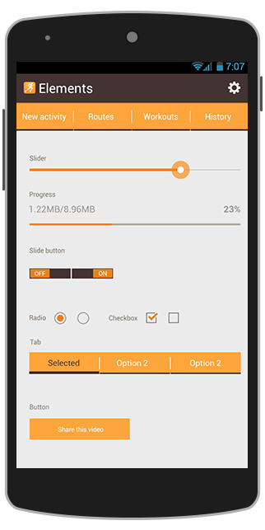
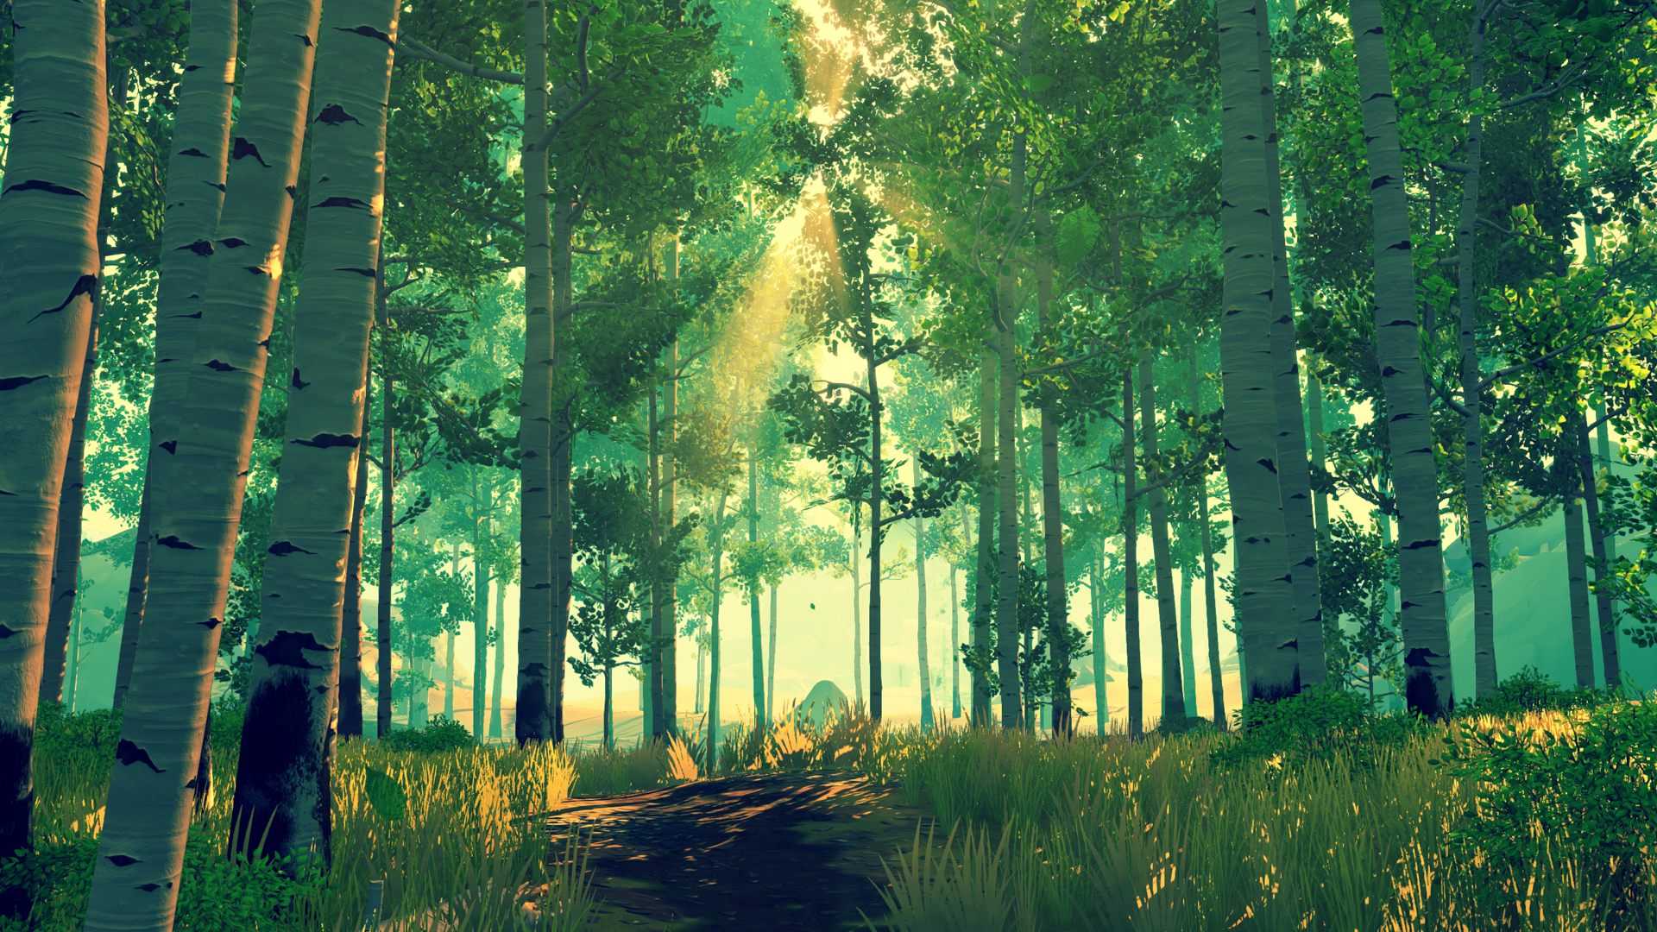



Start
Flying
Let’s blow a virtual bubble!

Slide 4
Step 3: Advanced graphics
Sang-Gyun
Refine the game logic
Dying bubble
Trajectory of bubble
Hoon Min
Item generator
Triplanar mapping for mountain
Map transparency control
Jong Min
Bubble - Map collision
Waving sea

Slide 5
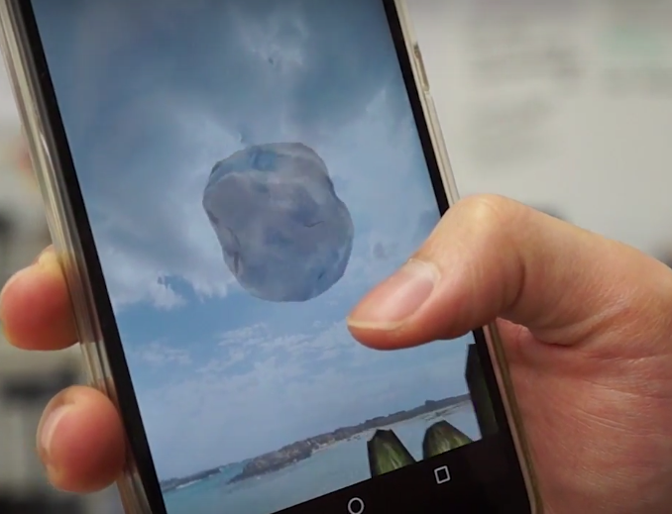
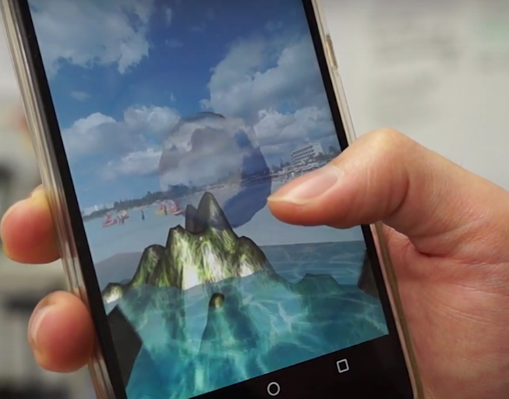
Refine the game logic
Get all Items scattered around the map.
Bubble shrinks as time passed or it collides to obstacles.
Radius of the bubble recovers by getting an item.

Slide 6
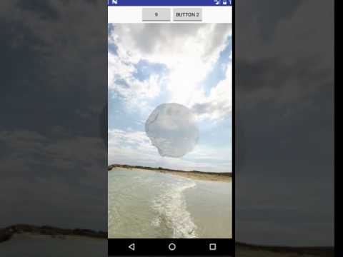
Dying bubble as time passed
Decrease bubble’s radius as time passed

Slide 7
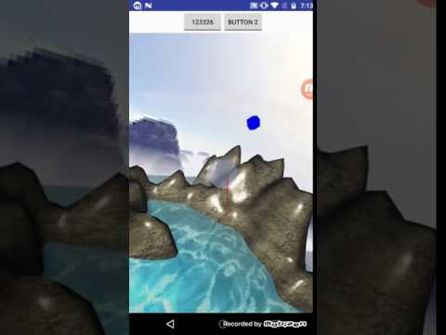
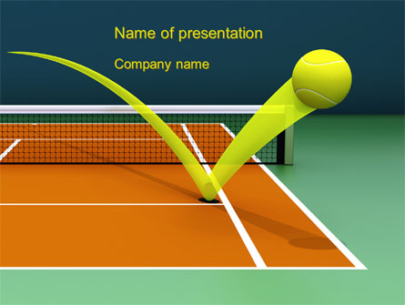
Trajectory of bubble
To help to understand spatial locomotion of bubble

Slide 8
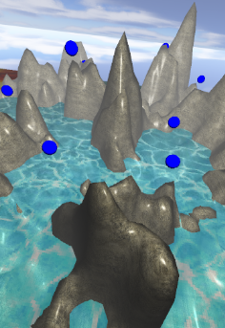
Item generator
To avoid overlapping of items and the map, we implemented own algorithm for putting items.
After we choose the location of an item, we use the height information of the map to determine the minimum height of the item such that it does not overlap with the mountains.

Slide 9
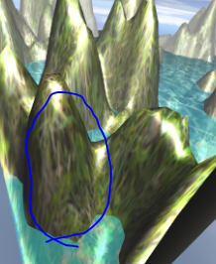
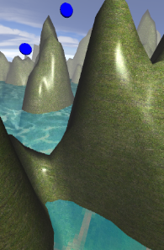
Triplanar mapping for mountain
By using the triplanar mapping technique, we solved the distortion problem of texture.
We’re planning to combine normal(bump) mapping with this mapping to give more realistic effect.

Slide 10
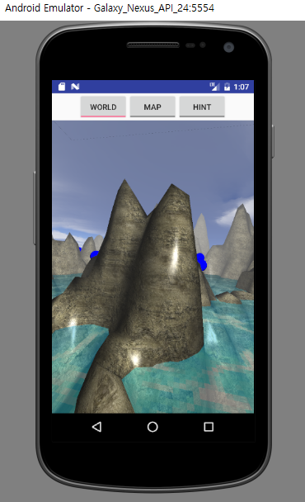
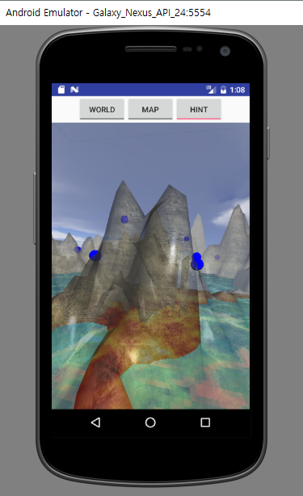
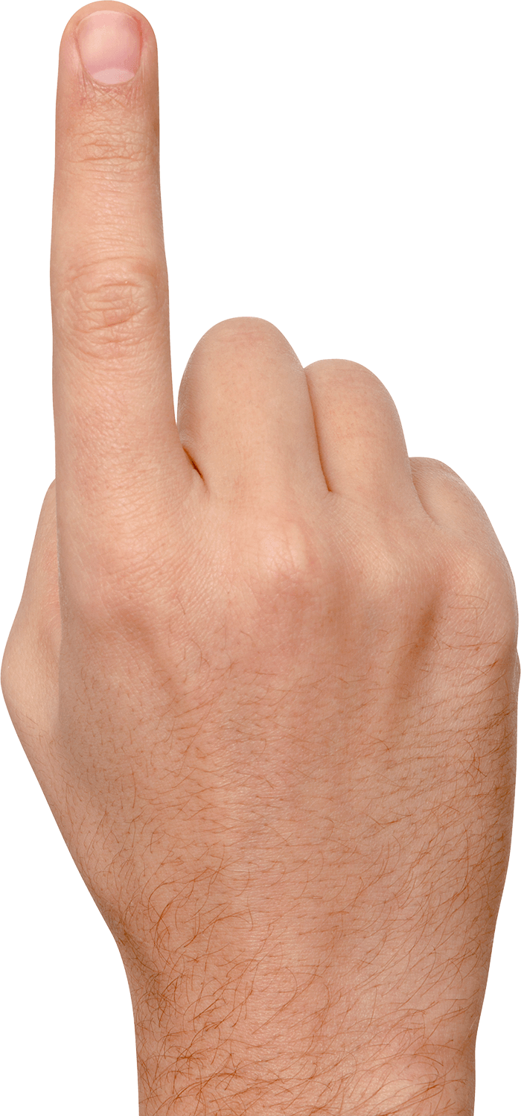
Map transparency control (by touch)
We implemented a little ‘hint’ function which helps the player to glimpse the items while touching.
Invoking method of this function will be changed according to the difficulty of the game.

Slide 11
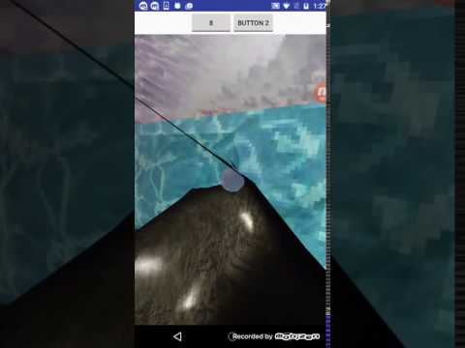
Bubble - Map collision

Slide 12
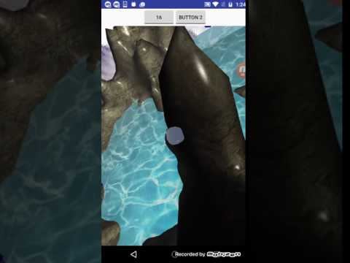
Waving sea

Slide 13
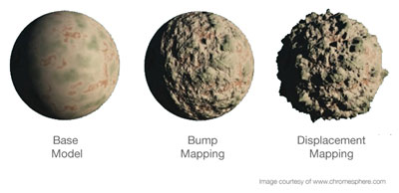
Next step
Improving graphics
Bump mapping + triplanar mapping
Game info display
Play time
# of items
User study

Slide 14
Thank U

Slide 15
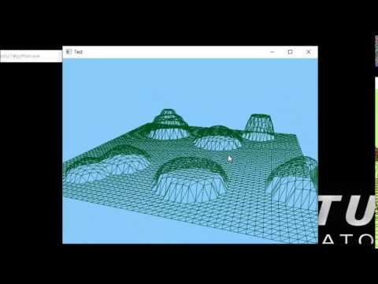
GL 3D world + Map generator
Draw a large square first.
Divide it into evenly-spaced small squares.
Pick a point P among the vertices. Let h and r height and radius of the ‘hill’.
For the points X = (x, y, z) such that |X-P| ≤ r, replace the value of y to y_new = max(h*exp(-(|X-P|/r)^2), y)
This makes a ‘hill’ on the map.
Modifying the formula gives us different kinds of hills. ex) ‘stairs’, ‘cliffs’, etc.

Slide 16
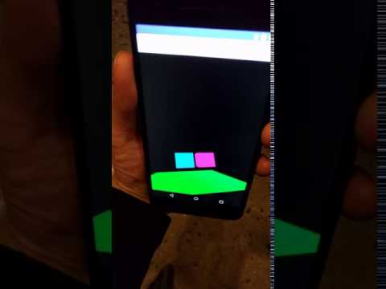
Rotate view by rotating Android device
Gyroscope sensor

Slide 17
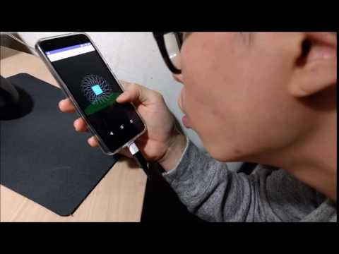
Move object by blowing
Android microphone → sound level → translation matrix

Slide 18
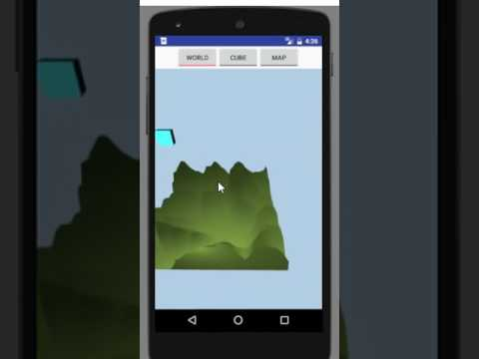
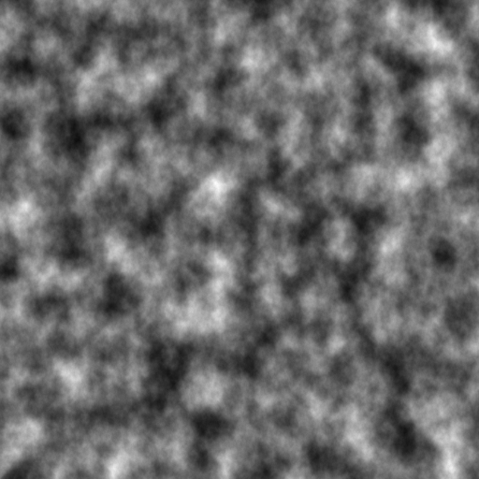
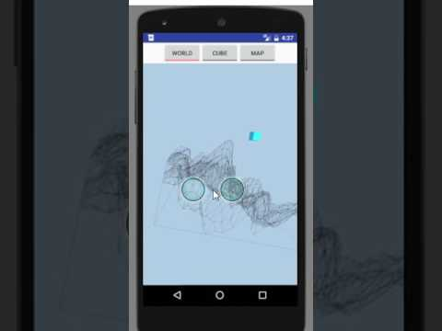
Advanced map generator
How
Perlin noise (gradient noise) * Ken Perlin. 1985. An image synthesizer. In Proceedings of the 12th annual conference on Computer graphics and interactive techniques (SIGGRAPH '85). ACM, New York, NY, USA, 287-296.
Trials
Diamond algorithm
etc.

Slide 19
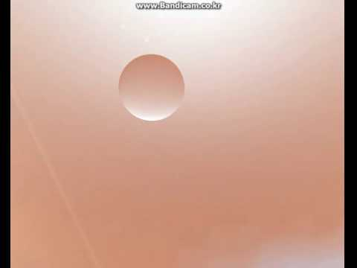
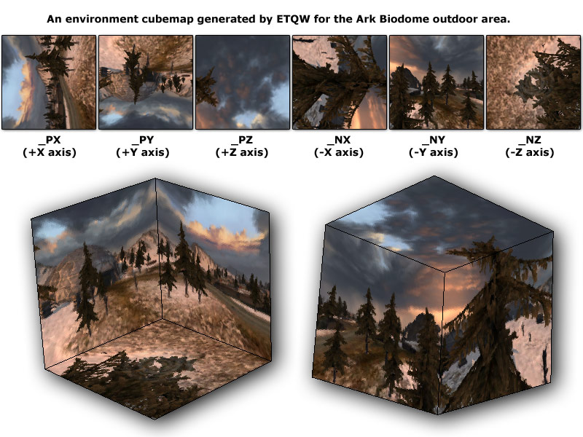
Environmental texture mapping
How
Cube maps

Slide 20
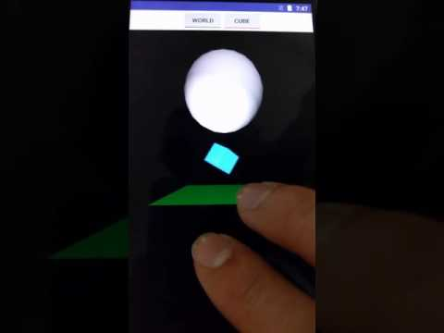


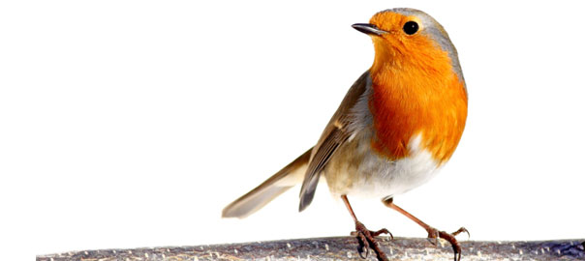
Collision detection
How
bounding box/sphere
3.4km

Slide 21
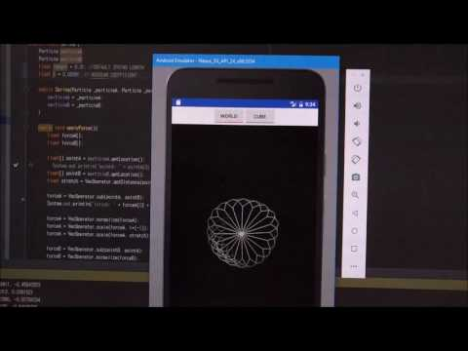
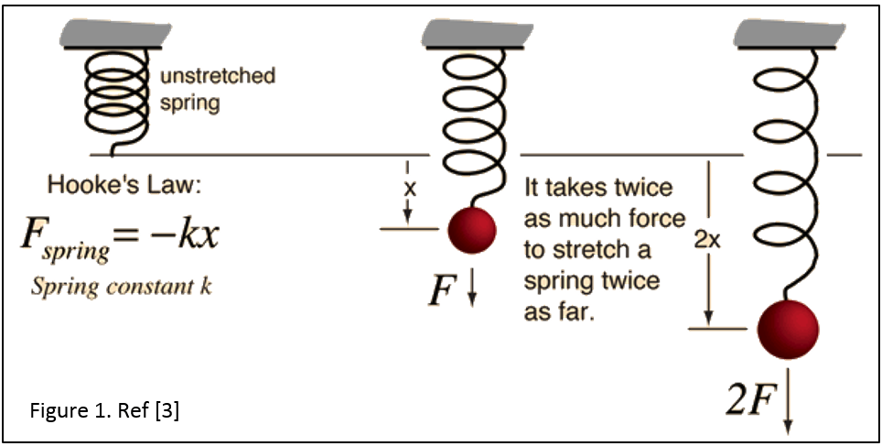
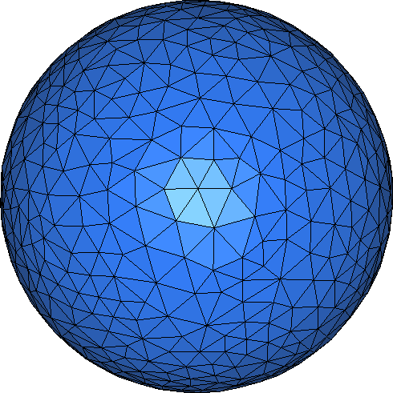
Spring-mass model
How
Spring-mass model
Future work
Dragging force to decrease oscillation.
Gravity.
Breath (wind) pressure.
etc.

Slide 22
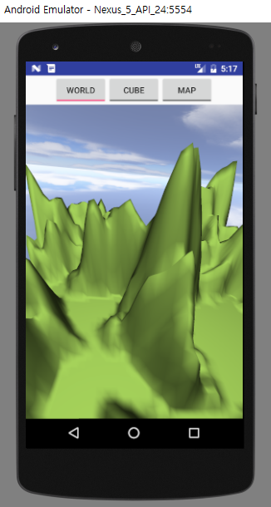
Detailed map
Make the map more realistic!
Add ‘sea’ on the specific height
Apply Texture mapping
Blinn-phong shading
Haze effect
Alpha blending

Slide 23
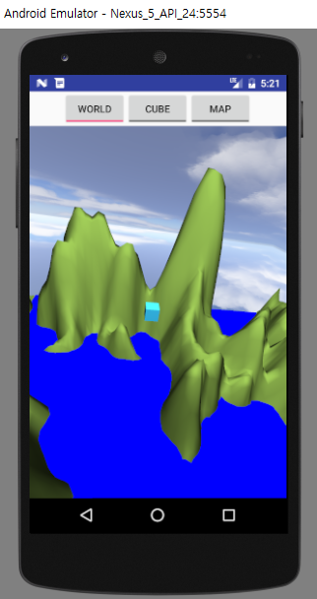
Detailed map
Make the map more realistic!
Add ‘sea’ on the specific height
Apply Texture mapping
Blinn-phong shading
Haze effect
Alpha blending

Slide 24
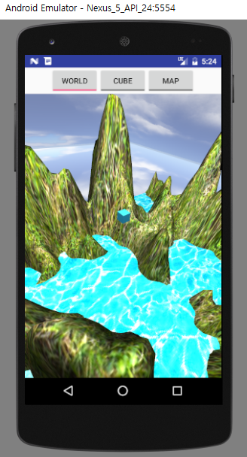
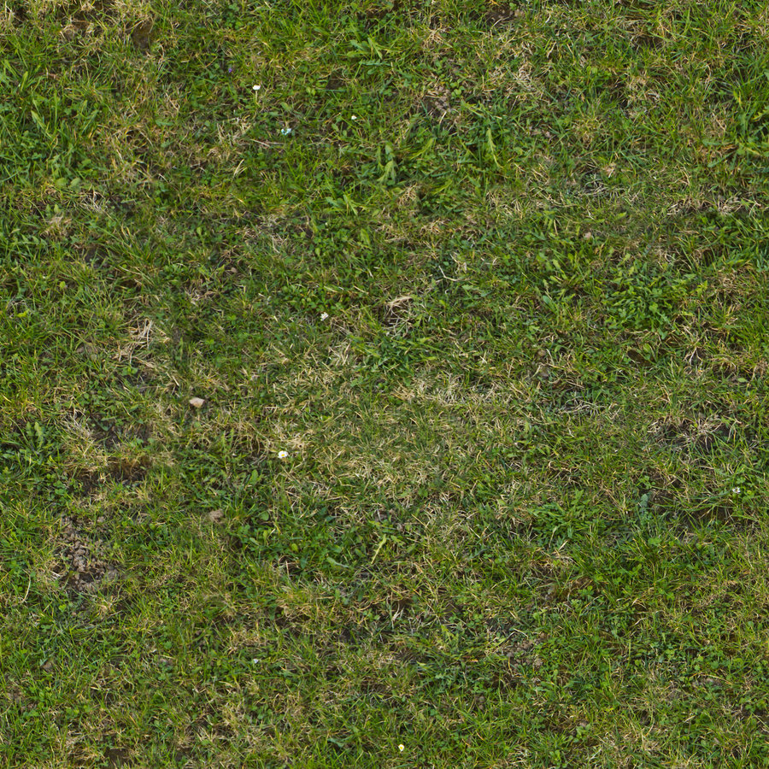

Detailed map
Make the map more realistic!
Add ‘sea’ on the specific height
Apply Texture mapping
Blinn-phong shading
Haze effect
Alpha blending

Slide 25
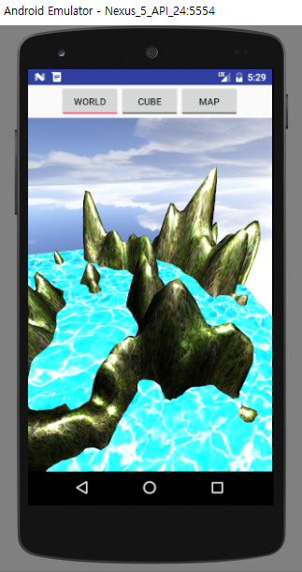
Detailed map
Make the map more realistic!
Add ‘sea’ on the specific height
Apply Texture mapping
Blinn-phong shading
Haze effect
Alpha blending

Slide 26
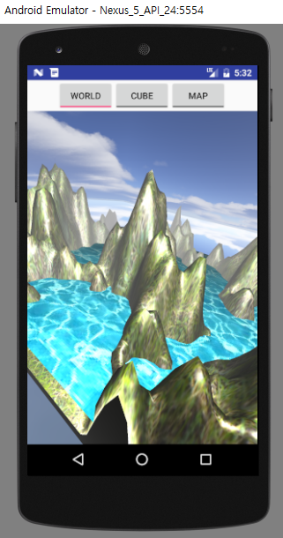
Detailed map
Make the map more realistic!
Add ‘sea’ on the specific height
Apply Texture mapping
Blinn-phong shading
Haze effect
Alpha blending
finalColor = r * originalColor + (1 - r) * fogColor

Slide 27
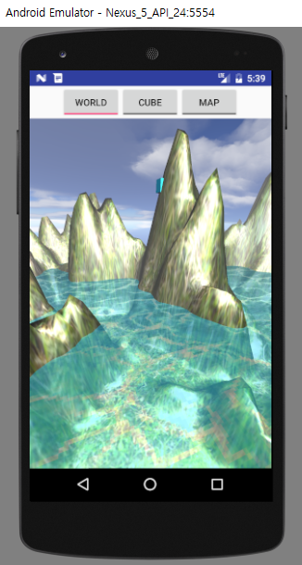
Detailed map
Make the map more realistic!
Add ‘sea’ on the specific height
Apply Texture mapping
Blinn-phong shading
Haze effect
Alpha blending
…
GLES20.glEnable(GLES20.GL_BLEND);
GLES20.glBlendFunc(GL_SRC_ALPHA, …);
mSea.draw(...)
...

Slide 28
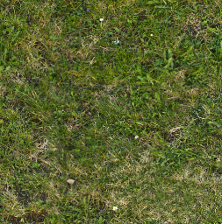
Detailed map
Challenges
Distortion of texture
Possible solutions
Tri-planar texture mapping
Use colorMap instead of texture
etc.

Slide 29
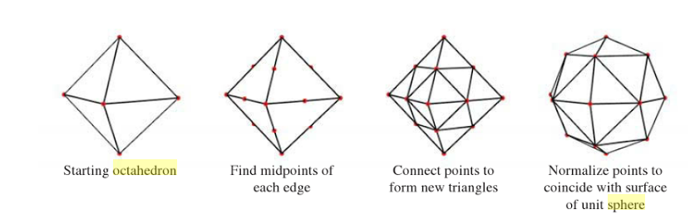
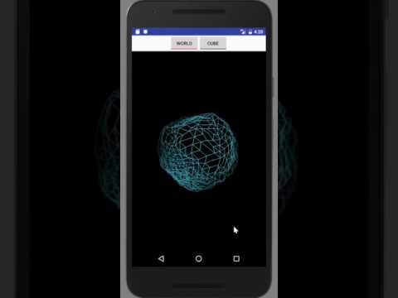
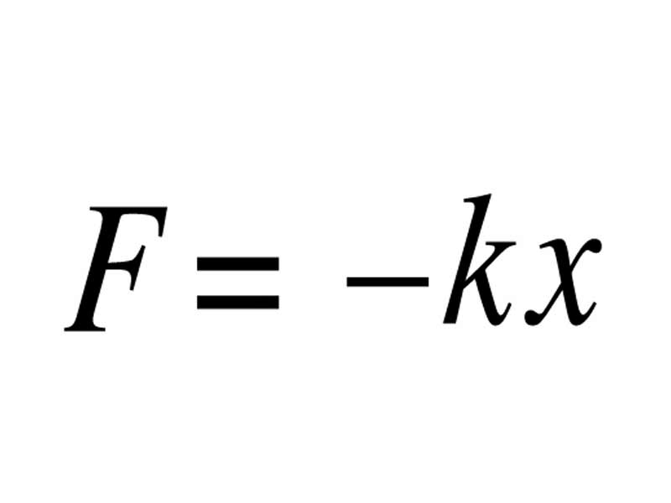

Naturally deforming bubble
Spring force → acceleration → displacement
Spring-mass model
Tuned parameters
Number of vertices
Velocity damping ratio
Spring length of rest state
Hooke’s constant
Mass of vertex

Slide 30
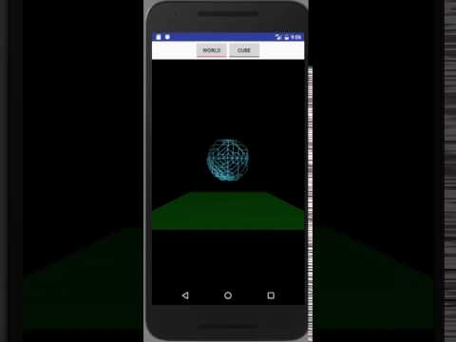
Natural move of bubble
Gravity → acceleration → displacement
Tuned parameter
Constant G
Velocity damping ratio
Mass of vertex

Slide 31
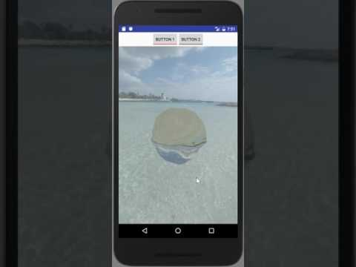
Natural look of bubble
Cube maps
Alpha blending

Slide 32
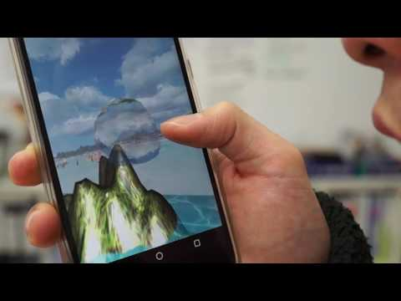
Natural control of bubble
Blowing pressure → acceleration → displacement
Force direction: camera’s view vector
Camera following the bubble

